Slide 1
Core Java
Mrs. A. S. Pardeshi

Slide 2
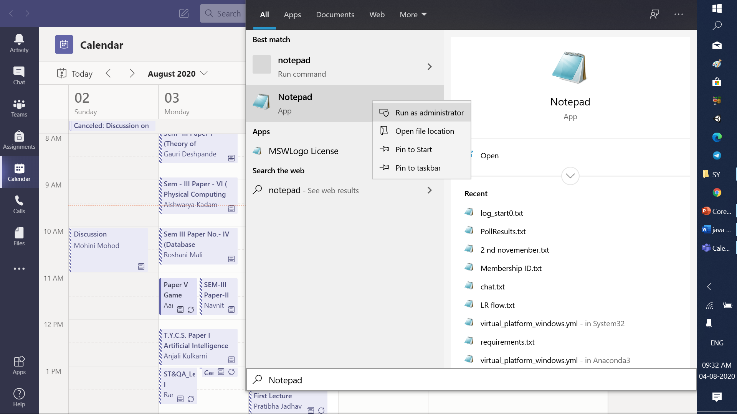
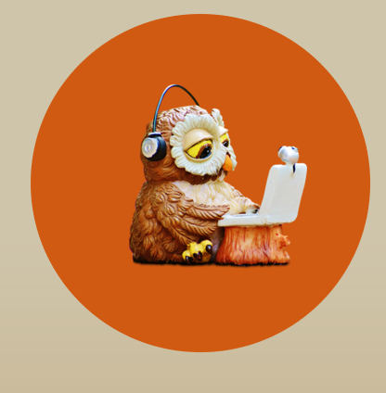
Steps

Slide 3
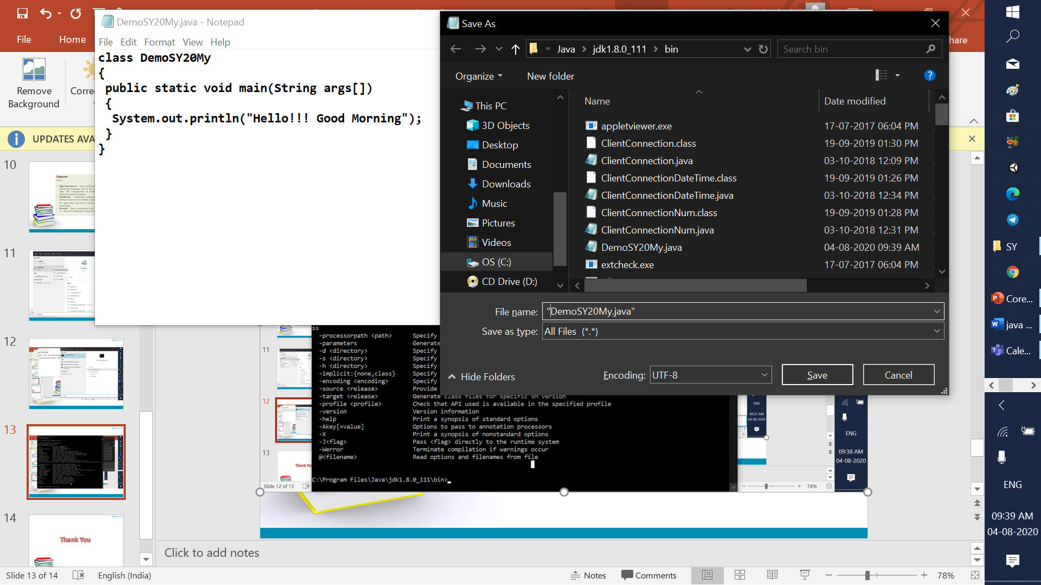
Steps

Slide 4
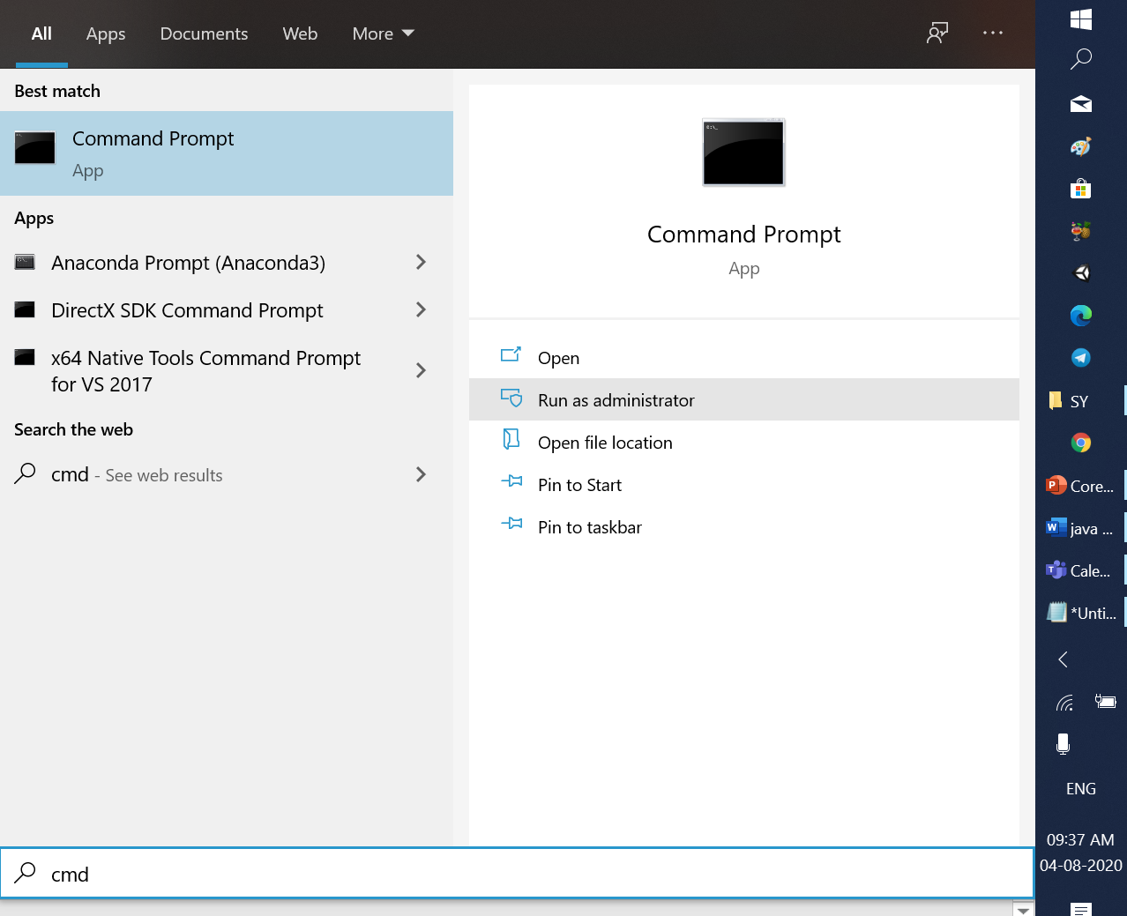
Steps

Slide 5
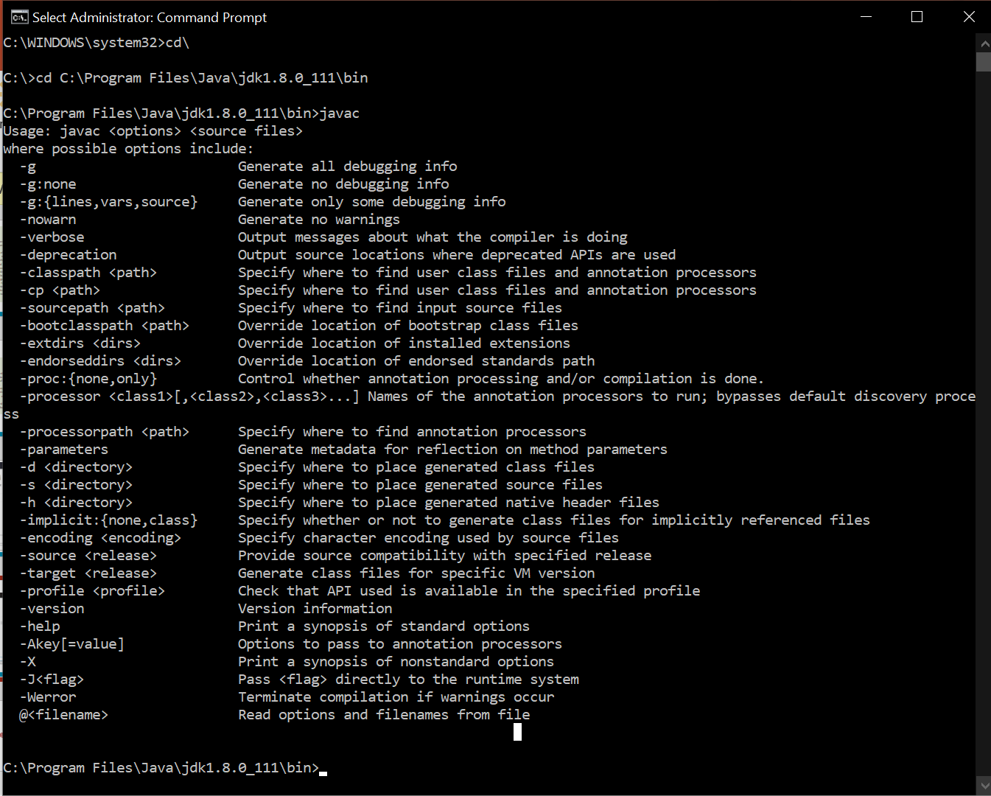
Steps

Slide 6
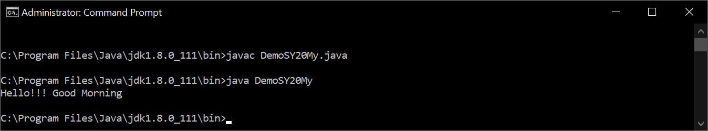
Steps

Slide 7
Basics
Whitespace
Java is a free-form language. This means that you do not need to follow any special indentation rules. For instance, the Example program could have been written all on one line, as long as there was at least one whitespace character between each token. In Java, whitespace is a space, tab, or newline.

Slide 8
Basics
For ex.
Space: class Demo
Tab: class Demo
Newline: class Demo{} or
class Demo class Demo{
{ }
}

Slide 9
Basics
Literals
A constant value in Java is created by using a literal
representation of it.
For example, here are some literals:
100 98.6 'X’ "This is a test"
Left to right, the first literal specifies an integer, the next is a floating-point value, the third is a character constant, and the last is a string. A literal can be used anywhere a value of its type is allowed.

Slide 10
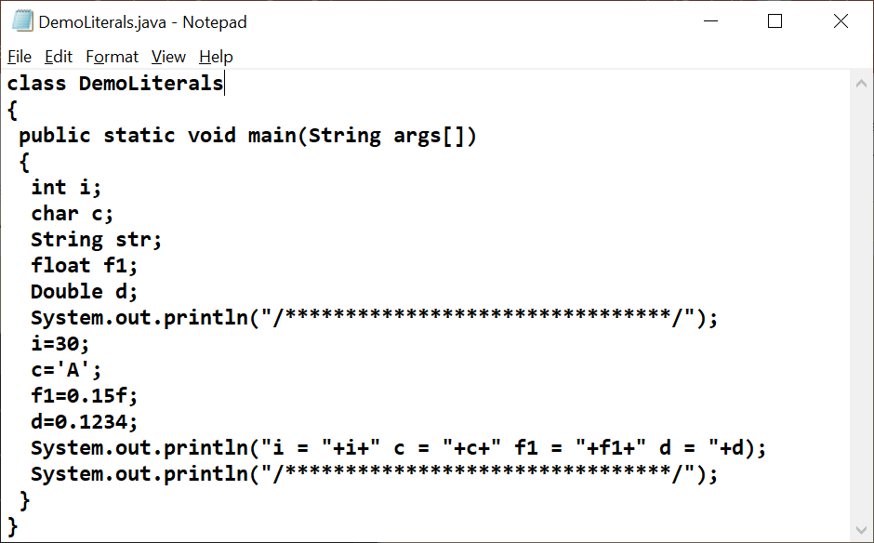

Slide 11
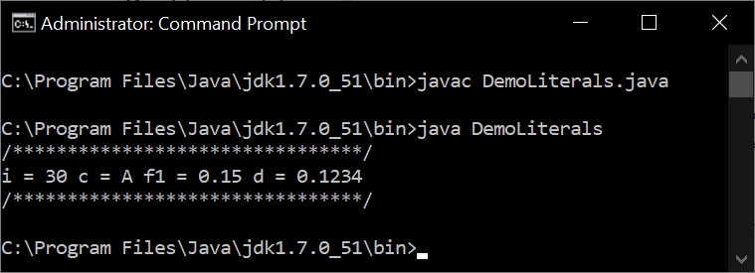

Slide 12
Comments
There are three types of comments defined by Java.
You have already seen two in C language:
single-line // and multiline /* */
For ex.
//This is single line comment
/* This is multiline comment
compiler will ignore the commented part
*/

Slide 13
Comments
The third type is called a documentation comment. This type of comment is used to produce an HTML file that documents your program. The documentation comment
begins with a /** and ends with a */.
For ex.
/**
* The HelloWorld program implements
* an application that simply displays *"Hello World!" to the standard output. * @author Zara Ali * @version 1.0
* @since 2014-03-31
*/

Slide 14
Separators
In Java, there are a few characters that are used as separators.
The most commonly used separator in Java is the semicolon.
It is used to terminate statements.
Symbol Name Purpose ( ) Parentheses Used to contain lists of parameters in method definition and invocation. Also used for
defining precedence in expressions, containing expressions in
control statements, and surrounding cast types.

Slide 15
Separators
{ } Braces Used to contain the values of automatically initialized arrays. Also used to define a block of code, for classes, methods, and local scopes.
[ ] Brackets Used to declare array types. Also used when
dereferencing array values.

Slide 16
Separators
; Semicolon Terminates statements.
Comma Separates consecutive identifiers in a variable declaration. Also used to chain statements together inside a for statement.
. Period Used to separate package names from subpackages and
classes. Also used to separate a variable or method from a
reference variable.

Slide 17
The Java Keywords
There are 50 keywords currently defined in the Java language.
These keywords, combined with the syntax of the operators and
separators, form the foundation of the Java language. These keywords cannot be used as names for a variable, class, or method. The
keywords const and goto are reserved but not used. In the early days of Java, several other keywords were reserved for possible future use. In addition to the keywords, Java reserves the following: true, false, and null. These are values defined by Java. You may not use these
words for the names of variables, classes, and so on.

Slide 18
Java Is a Strongly Typed Language
Java is a strongly typed language because in Java safety and
robustness comes from these fact.
1. Every variable has a type, every expression has a type, and every type is strictly defined.
2. All assignments, whether explicit or via parameter passing in
method calls, are checked for type compatibility. There are no
automatic conversions of conflicting types. The Java compiler
checks all expressions and parameters to ensure that the types are
compatible. Any type mismatches are errors that must be corrected before the compiler will finish compiling the class.

Slide 19

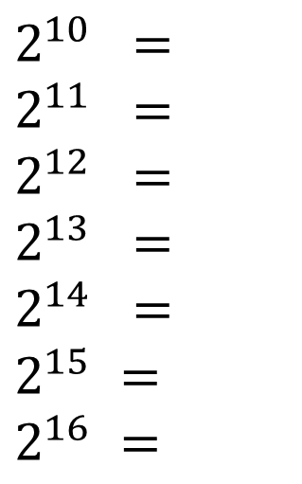
$$2^{0} =$$
$$2^{1} =$$
$$2^{2} =$$
$$2^{3} =$$
$$2^{4} =$$
$$2^{5} =$$
$$2^{6} =$$
$$2^{7} =$$
$$2^{8} =$$
$$2^{9} =$$
$$2^{10}=$$
$$2^{10} =$$
$$2^{11} =$$
$$2^{12} =$$
$$2^{13} =$$
$$2^{14} =$$
$$2^{15} =$$
$$2^{16} =$$

Slide 20

















$$2^{0} = 1$$
$$2^{11} = 2048$$
$$2^{1} = 2$$
$$2^{12} = 4096$$
$2^{2} =$4
$2^{13} =$8192
$2^{3} =$ 8
$2^{14} =$ 16384
$$2^{4} =16$$
$$2^{15} =32768$$
$2^{5} =$ 32
$2^{16} =$ 65536
$2^{6} =$ 64
$2^{7} =$ 128
$2^{8} =$ 256
$$2^{9} =512$$
$$2^{10}=1024$$

Slide 21
Thank you

